Slide 1
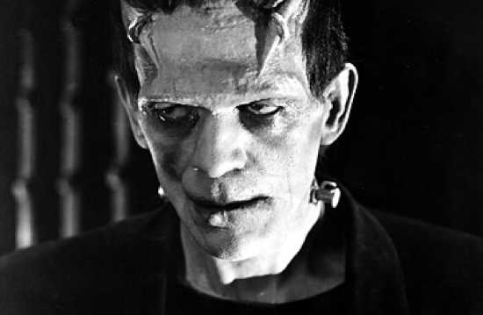
Who was Golem?
Which companies build the most advanced robots?
What was a Brazen Head?
What is OPENCV?
What robot belonged to Saint Albert the Bishop?
What are applications of ORANGE system?
Which famous robot originates from Prague?
What are applications of PROLOG language in robotics?
Which old-time automaton is associated with Napoleon Bonaparte ?
What is Arduino?
What is a servo, explain?
What is a pulsewise modulation?
Tell us famous robots in history of Europe?
What is Fuzzy Logic?
What are robotics classes at PSU ?
What is Inverse Kinematics?
What is a robot?
What are famous Japanese robots?
What are Machine Learning and Computer Vision classes at PSU?
Which famous scientist built robots for theatre in ancient Egypt?
Which Law of Boolean Algebra is not true in Fuzzy Logic?
Why Frankenstein Monster is famous?
Explain kinematics of humanoid robot arm?
Explain Fast Walsh Transform?
List famous automatons from 18 and 19 Century?
What is android?
What are most important sensors for mobile robot?
Which country has the most industrial robots installed?
What is a humanoid robot?
Explain acronym IGA and how it is used in robot theatre?
What is PID controller?
What are basic functions of language LISP?
Tell about Nao robot
What kind of gears are used in robotics?
What is Genetic Algorithm?
What is genetic Programming ?
What is the problem with building an android robot arm?
What is the name of biped robot that can be purchased from Intel?
Notes:
Questions about Robotics and history of robotics and robot theatre

Slide 2
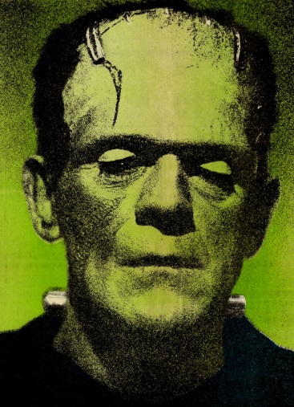
How Monster looked like?
In which country Frankenstein worked ?
What was the title of Frankenstain? What was his education?
What are Artificial Neural Networks?
What is modal logic?
What is Hartenberg-Denawitt Notation?
Hough Transform?
What are uses of Haar Transform?
What is Neuro-Fuzzy Network?
Explain briefly Viola-Jones Algorithm
What is Edge Detection?
Can you explain the Principal Component Analysis?
What is SVR standing for?
List all known to you algorithms for Machine Learning
Uses of Decision Trees in Robotics?
Main ideas of language REBEL ?
What is Hidden Markov Model?
Applications of Temporal Logic in robotics?
What is temporal logic?
What are wavelets? Examples?
Explain Convolution and applications in Robotics.
What is Naïve Bayes?
What is Image Enhancement?
What are Ensemble Methods?
What is robot morality?
Matrices of Fast Transforms versus Butterflies
Principles of Path Planning
Give examples of trees in image processing?
What is Breadth First Search?
What is entropy and how we use it?
Notes:
Questions related to the Robotics classes that can be asked at the end of Spring Quarter.

Slide 3
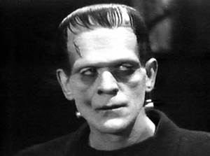
What are the departments in PSU Maseeh College of Engineering and Computer Science?
Who are the professors in Design Automation ?
What are the tracks in Electrical and Computer Engineering ?
What classes are related to Embedded Systems?
What kind of help I can get from ECE office?
What classes are about Computer Architecture?
Classes about VHDL, Verilog, System Verilog?
Who teaches Nanotechnology?
Can I take classes in Summer?
Is 478 class easy?
In what building is Electrical and Computer Engineering located?
In which room is the robotic laboratory?
Do you have many friends?
Who teaches Evolutionary Computation?
Where is Electromagnetics Lab?
What are classes in ECE related to medical applications?
You are admired for your accomplishments.
How many credits a quarter I should take?
What classes are taught by Professor Perkowski ?
What classes are taught by Professor Hall ?
Where is Nano Lab?
What is FPGA standing for?
What classes are taught by Professor Faust ?
What is IGA standing for?.
What abilities and skills are most important for an incoming ECE student?
Who teaches programming?
In which class there are no projects?
In which class there are many projects?
What are the prerecquisities to robotics classes?
Notes:
Questions of incoming students to Electrical and Computer Engineering Department.

Slide 4
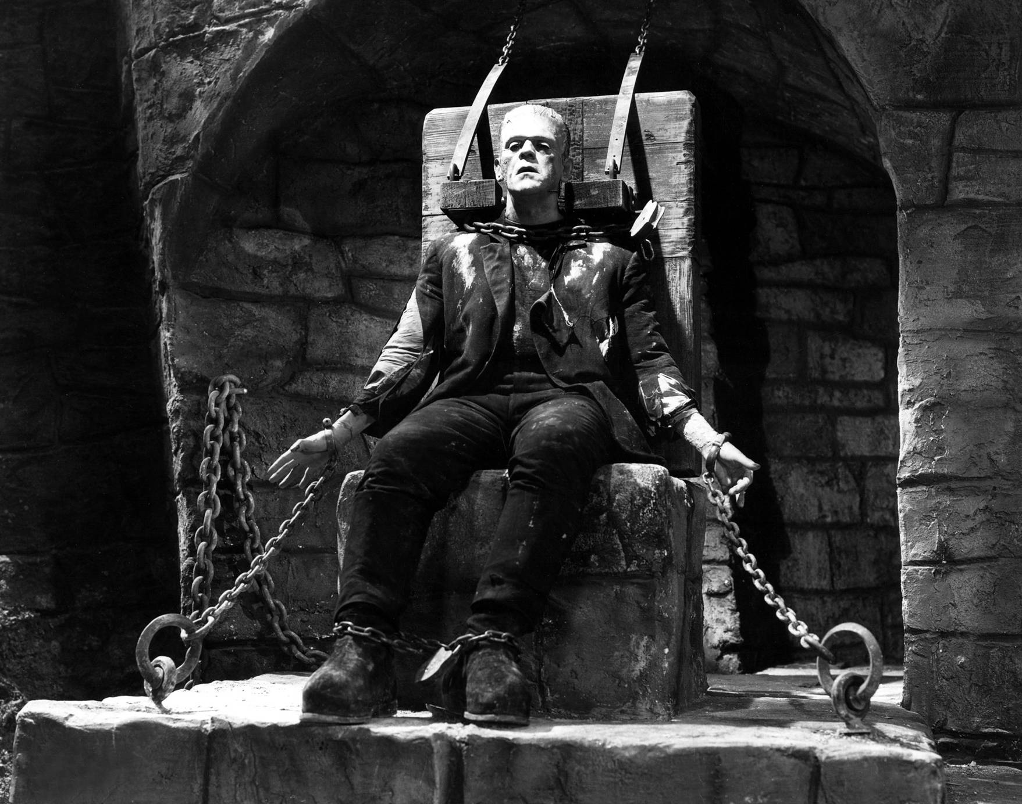
Definitely, I did not look in reality like on this photograph.
Notes:
Answer to a question “How did you look like, Frankenstein’s Monster?

Slide 5
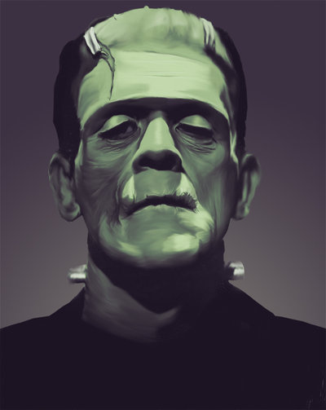
Interaction 3.12 (Dramatic Variant) Fishes (on the flower-covered wall of BackBot) Fishes sing and move in turn.
Frankenstein’s Monster (sleeps and snores. Is awaken by the fish. Starts to move slowly in a dignified way, as awaken to a new life after centuries of non-existence) What? Where am I? Strange space? Fishes talk? (he is surprised) It cannot be. Am I drunken? Is it a fairy tale? Master Frankenstein always amazes me. Why he wants fishes? Where is he? (moves in pendulum way forward and backward, first quickly, then motion slowly disappears)
Notes:
Fishes

Slide 6
Interaction 3.5 (Happy Variant) Countess Quanta (looks with surprise around) But… nobody works here. Everybody celebrates only…
Lights are dimmed. Suddenly a loud music is heard, many young voices.
Frankenstein Monster. (explains enthusiastically) We do not work because… Countess Quanta: … we have a graduation ceremony today.
Notes:
Countess Quanta

Slide 7
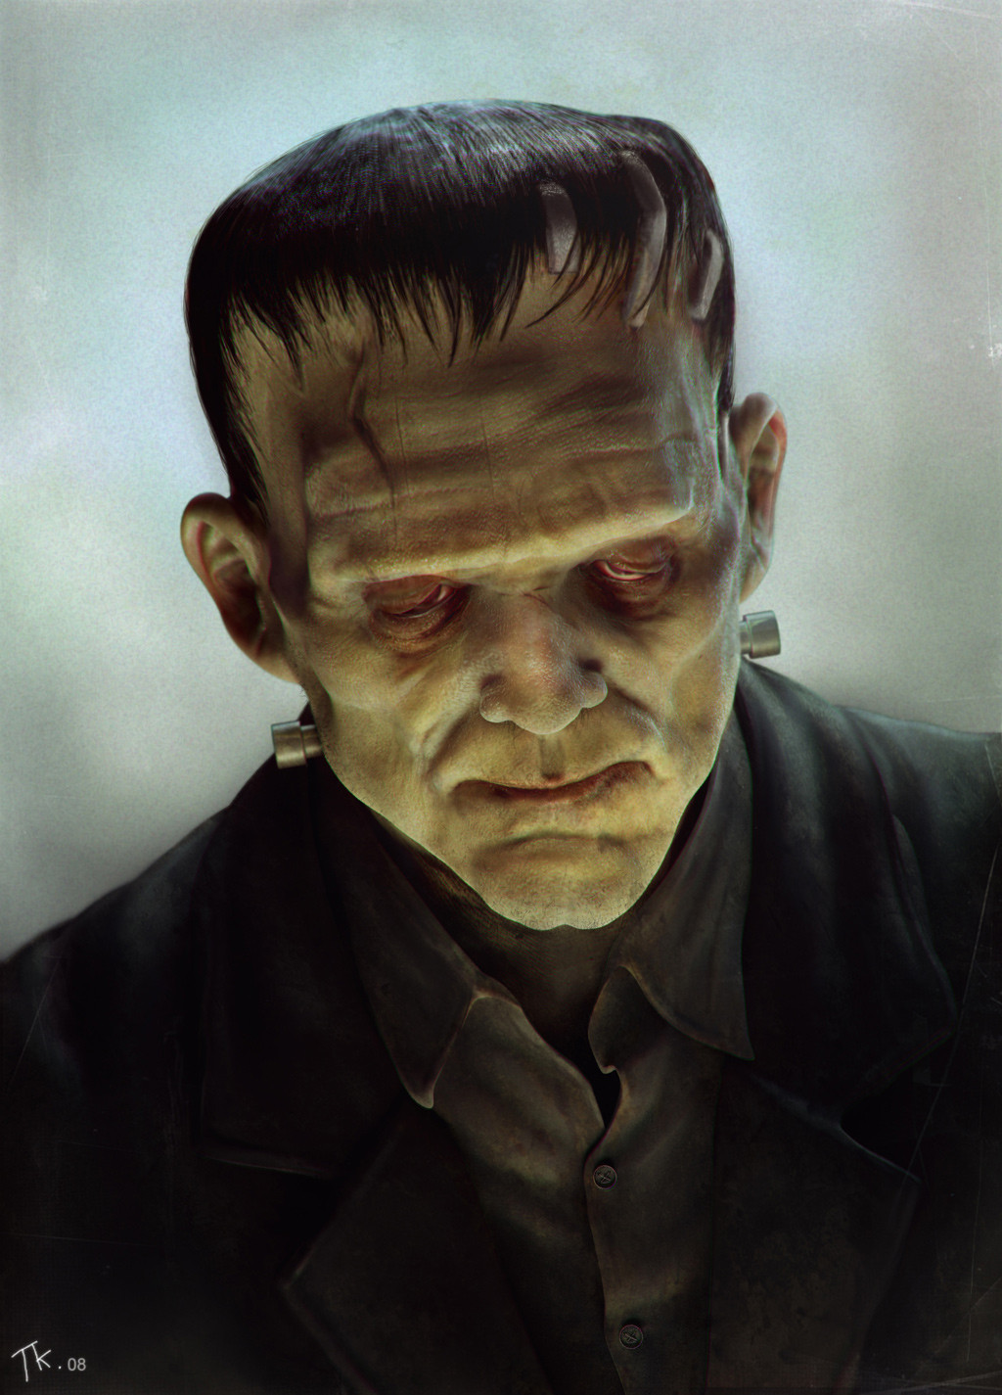
Countess Quanta (looks with surprise around) They have good time at PSU. … Schrödinger Cat. And they do not work…
Bohr: (to Countess Quanta) And who are these two crippled monsters? (shows to Golem and Frankenstein Monster) Golem and Frankenstein Monster make offended gestures. Countess Quanta: We do not use this word now, you know, we are now politically correct. They work here as research scientists and lab technicians. Golem and Frankenstein Monster (They dance, play guitars and perform their standard tricks).
Notes:
Bohr

Slide 8
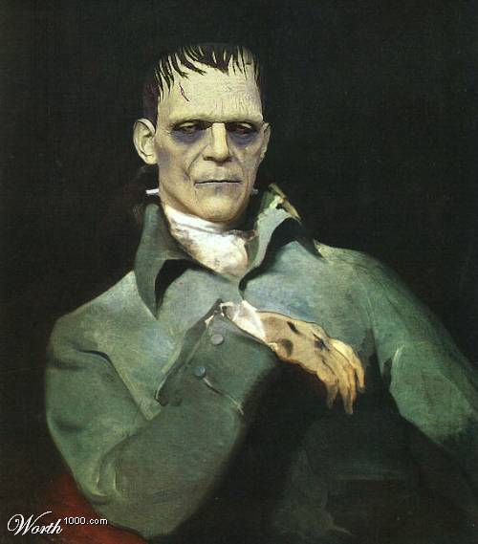
Interaction 3.7 (Happy Variant) The light points to a strange figure hanging in the air. Einstein: Who is this? Or what? (to monster) Hey, are you alive? Who are you? Frankenstein Monster: I am the first quantumly conscious being ever created. My real name is Josephus, but I am popularly known as Frankenstein’s Monster, because it was Doctor Frankenstein from Germany who built me first before Countess resurrected me recently.

Slide 9
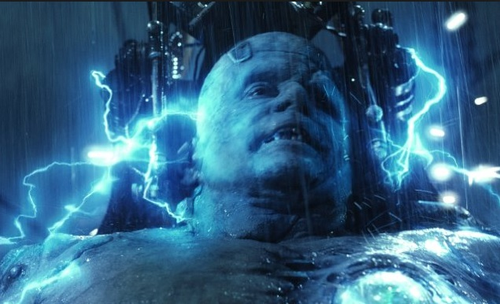
The light points to a strange large figure at the back of the room.
Brazen Head, Golem and Frankenstein’s Monster (speak with one voice together) Recently we were teleported, entangled and resurrected to help the research in this lab.

Slide 10
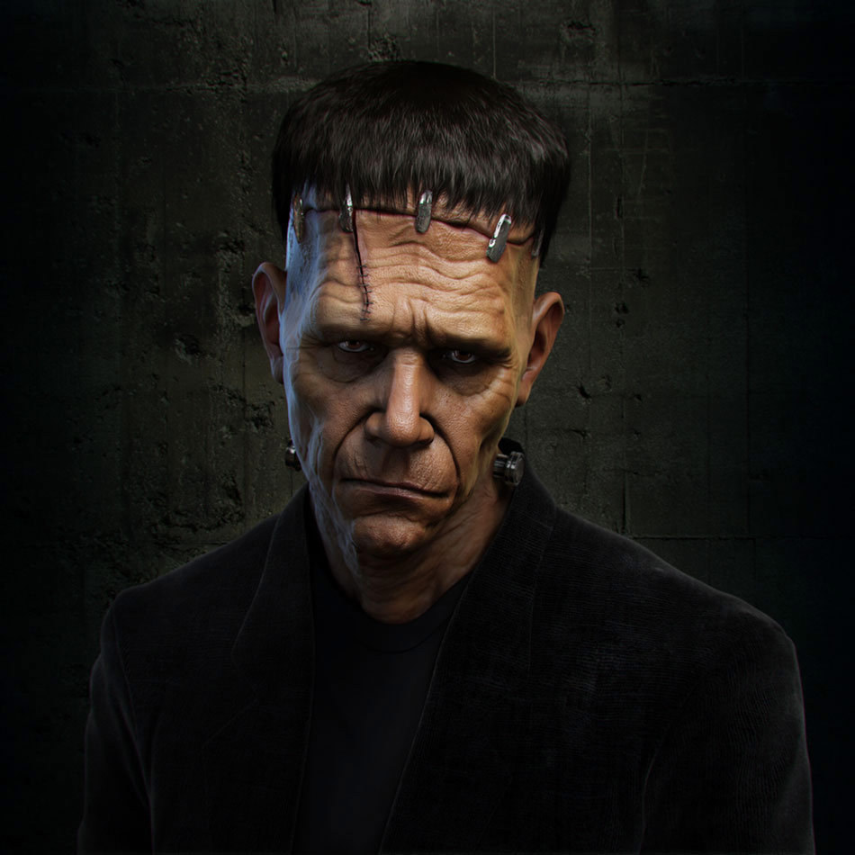
This is how I was constructed
Notes:
How you were constructed?

Slide 11
What do you think about future of robotics?

Slide 12
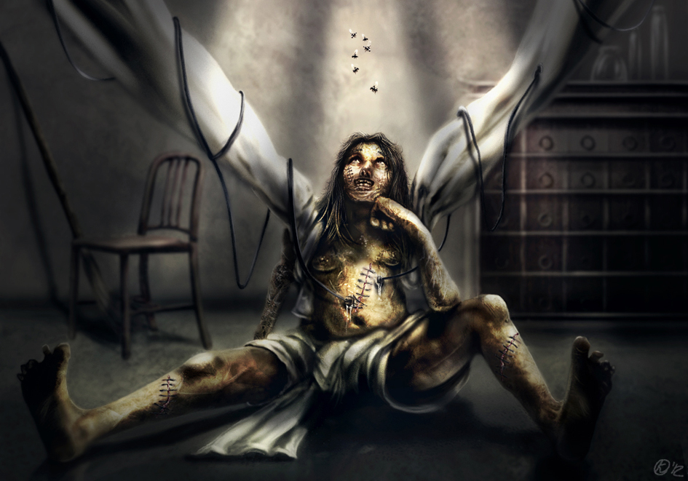
Notes:
Answer to question if Monster was happy or not. The novel's title compares "Frankenstein" to the mythological figure Prometheus, because of what they both brought to life.
In Shelley's horror story, Victor Frankenstein builds the creature in his laboratory through an ambiguous method consisting of chemistry and alchemy. Shelley describes the monster as 8-foot-tall (2.4 m), hideously ugly, but sensitive and emotional. The monster attempts to fit into human society, but is shunned, which leads him to seek revenge against his creator

Slide 13
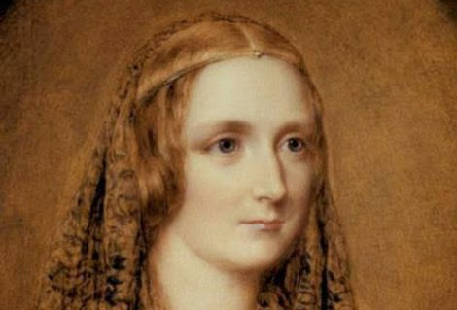
Mary Wollstonecraft Shelley was an English novelist, short story writer, dramatist, essayist, biographer, and travel writer, best known for her Gothic novel Frankenstein: or, The Modern Prometheus.
She also edited and promoted the works of her husband, the Romantic poet and philosopher Percy Bysshe Shelley.
Notes:
Answer to question about Mary Shelley.

Slide 14
Type;#;command;value;delay narrator;1;say;"I am the theater narrator. We will begin by performing a self test. I thank you for your patience.";2 monster;1;say;"I am Monster. I am beginning my self test now";2 monster;1;say;"Turning head to the right";0 monster;1;move;faceright;1 monster;1;pause;5 monster;1;say;"Turning head to the left";0 monster;1;move;faceleft;1 monster;1;pause;5 monster;1;say;"I am doing motion my head to say no";0 monster;1;move;faceno;1 monster1;pause;5 monster;1;say;"moving forward";0 monster;1;move;f;2 monster;1;pause;3
Monster Test
Notes:
Monster Test

Slide 15
quanta;1;say;"I am Countess Quanta. I am beginning my self test now";2 quanta;1;say;"moving backward";0 quanta;1;move;b;2 quanta;1;pause;3 quanta;1;say;"turning left";0 quanta;1;move;l;2 quanta;1;pause;3 quanta;1;say;"turning right";0 quanta;1;move;r;3 quanta;1;say;"moving foward";0 quanta;1;move;f;2 quanta;1;pause;3 quanta;1;say;"moving backward";0 quanta;1;move;b;2 quanta;1;pause;3 quanta;1;say;"turning left";0 quanta;1;move;l;2 quanta;1;pause;3 quanta;1;say;"turning right";0 quanta;1;move;r;2 quanta;1;pause;3 quanta;1;say;"I am Countess Quanta. I have completed my self test now";2
Quanta Test

Slide 16
quanta;1;say;"moving backward";0 quanta;1;move;b;2 quanta;1;pause;3 quanta;1;say;"turning left";0 quanta;1;move;l;2 quanta;1;pause;3 quanta;1;say;"turning right";0 quanta;1;move;r;3 quanta;1;say;"I am Bohr. I have completed my self test now";2 quanta;1;say;"I am Schrodinger. I am beginning my self test now";2 quanta;1;say;"moving foward";0 schrodinger;1;move;f;2 schrodinger;1;pause;3 schrodinger;1;say;"moving backward";0 schrodinger;1;move;b;2 schrodinger;1;pause;3 schrodinger;1;say;"turning left";0 schrodinger;1;move;l;2 schrodinger;1;pause;3 schrodinger;1;say;"turning right";0 schrodinger;1;move;r;2 schrodinger;1;pause;3 schrodinger;1;say;"I am Schrodinger. I have completed my self test now";2
Quanta Test

Slide 17
bohr;1;say;"moving backward";0 bohr;1;move;b;2 bohr;1;pause;3 bohr;1;say;"turning left";0 bohr;1;move;l;2 bohr;1;pause;3 bohr;1;say;"turning right";0 bohr;1;move;r;3 bohr;1;say;"I am Bohr. I have completed my self test now";2 schrodinger;1;say;"I am Schrodinger. I am beginning my self test now";2 schrodinger;1;say;"moving foward";0 schrodinger;1;move;f;2 schrodinger;1;pause;3 schrodinger;1;say;"moving backward";0 schrodinger;1;move;b;2 schrodinger;1;pause;3 schrodinger;1;say;"turning left";0 schrodinger;1;move;l;2 schrodinger;1;pause;3 schrodinger;1;say;"turning right";0 schrodinger;1;move;r;2 schrodinger;1;pause;3 schrodinger;1;say;"I am Schrodinger. I have completed my self test now";2

Slide 18
bohr;1;say;"moving backward";0 bohr;1;move;b;2 bohr;1;pause;3 bohr;1;say;"turning left";0 bohr;1;move;l;2 bohr;1;pause;3 bohr;1;say;"turning right";0 bohr;1;move;r;3 bohr;1;say;"I am Bohr. I have completed my self test now";2 schrodinger;1;say;"I am Schrodinger. I am beginning my self test now";2 schrodinger;1;say;"moving foward";0 schrodinger;1;move;f;2 schrodinger;1;pause;3 schrodinger;1;say;"moving backward";0 schrodinger;1;move;b;2 schrodinger;1;pause;3 schrodinger;1;say;"turning left";0 schrodinger;1;move;l;2 schrodinger;1;pause;3 schrodinger;1;say;"turning right";0 schrodinger;1;move;r;2 schrodinger;1;pause;3 schrodinger;1;say;"I am Schrodinger. I have completed my self test now";2

Slide 19
Type;#;command;value;delay narrator;1;say;"I am the theater narrator. We will begin by performing a self test. I thank you for your patience.";2 bohr;1;say;"I am Bohr. I am beginning my self test now";2 bohr;1;say;"Turning head to the right";0 bohr;1;move;faceright;1 bohr;1;pause;5 bohr;1;say;"Turning head to the left";0 bohr;1;move;faceleft;1 bohr;1;pause;5 bohr;1;say;"I am motion my head to say no";0 bohr;1;move;faceno;1 bohr;1;pause;5 bohr;1;say;"moving forward";0 bohr;1;move;f;2 bohr;1;pause;3 bohr;1;say;"moving backward";0 bohr;1;move;b;2 bohr;1;pause;3 bohr;1;say;"turning left";0 bohr;1;move;l;2 bohr;1;pause;3 bohr;1;say;"turning right";0 bohr;1;move;r;3 bohr;1;say;"I am Bohr. I have completed my self test now";2 schrodinger;1;say;"I am Schrodinger. I am beginning my self test now";2 schrodinger;1;say;"moving foward";0 schrodinger;1;move;f;2 schrodinger;1;pause;3 schrodinger;1;say;"moving backward";0 schrodinger;1;move;b;2 schrodinger;1;pause;3 schrodinger;1;say;"turning left";0 schrodinger;1;move;l;2 schrodinger;1;pause;3 schrodinger;1;say;"turning right";0 schrodinger;1;move;r;2 schrodinger;1;pause;3 schrodinger;1;say;"I am Schrodinger. I have completed my self test now";2

